Slide 1
Using Data to Identify Priorities in an Accountability System
Jared E. Knowles, Wisconsin Department of Public Instruction

Slide 2
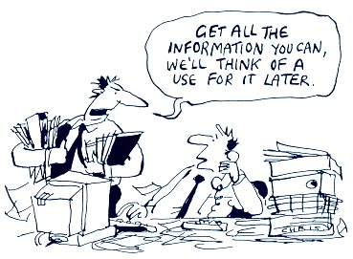
Opening Thought

Slide 3
Outline and Purpose
Provide context and background on Wisconsin’s position nationally on education indicators
Provide context on the economic situation in Wisconsin which students are being prepared for
Provide information about key indicators of Wisconsin performance using current data
Focus attention on key areas that can inform and instruct an accountability system

Slide 4
Where is Wisconsin’s testing and the economy today?
Context

Slide 5
Some definitions
Scale score—a student’s score on a standardized test
Cutpoints—the scale score that divides categories of performance like proficient and not-proficient
TIMSS—Trends in International Mathematics and Science Study, an international assessment
NAEP—National Assessment of Educational Progress, a national assessment in several subjects
Correlation—a measure from 0 to 1 of the interdependence of two measures

Slide 6
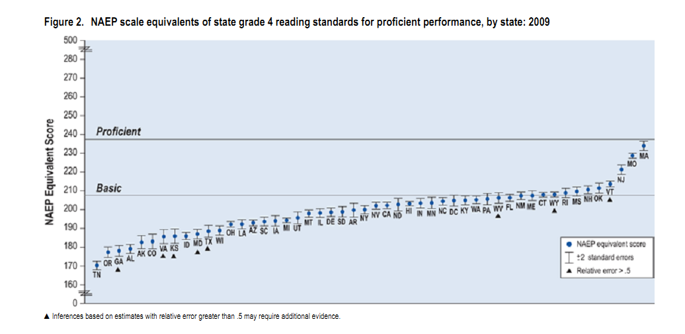
Scale Score Cutpoints in Perspective
Wisconsin sets proficiency cutpoints in reading well below NAEP basic and below other states

Slide 7
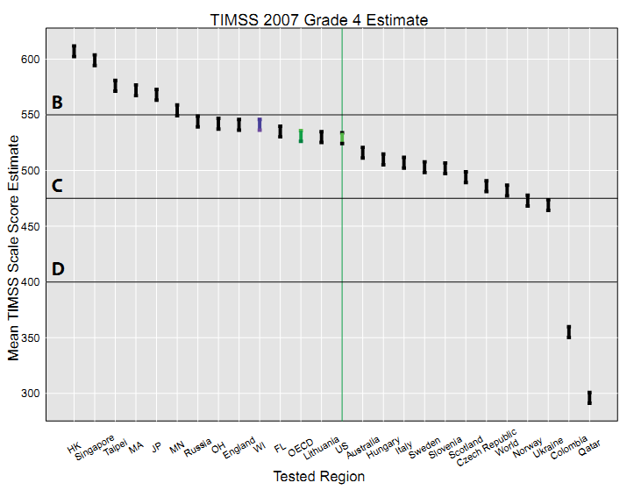
In international comparisons in math Wisconsin fares well

Slide 8
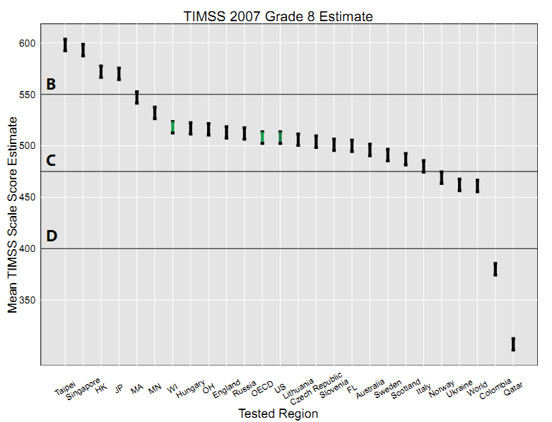
In international comparisons in math Wisconsin fares well

Slide 9
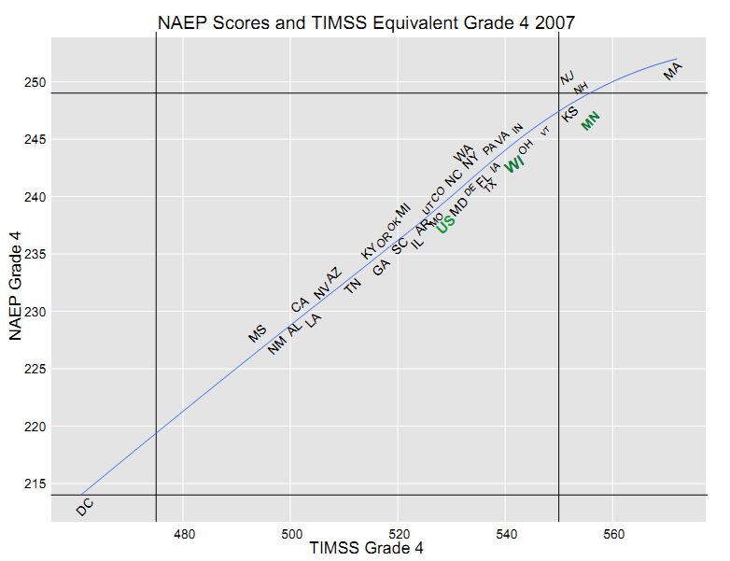
Proficient
C range
Wisconsin outperforms many states in math on TIMSS and NAEP
Basic
B range

Slide 10
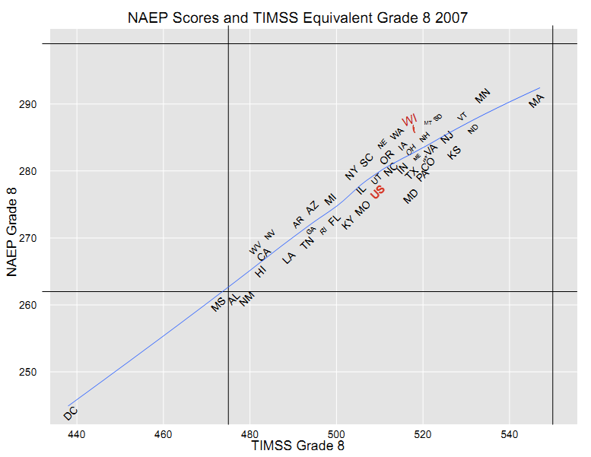
Proficient
C range
Wisconsin outperforms many states in math on TIMSS and NAEP
B range
Basic

Slide 11
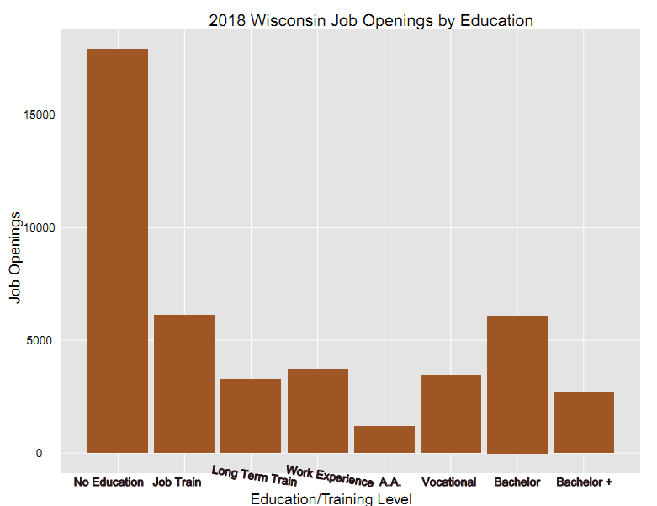
Many jobs require no post-secondary training or education, but several do require this

Slide 12
Education Matters for Unemployment
Source: NPR Planet Money Podcast #294: Planet Money Live (July 29, 2011); Bureau of Labor Statistics July 2011 Report (USDL-11-1151)

Slide 13
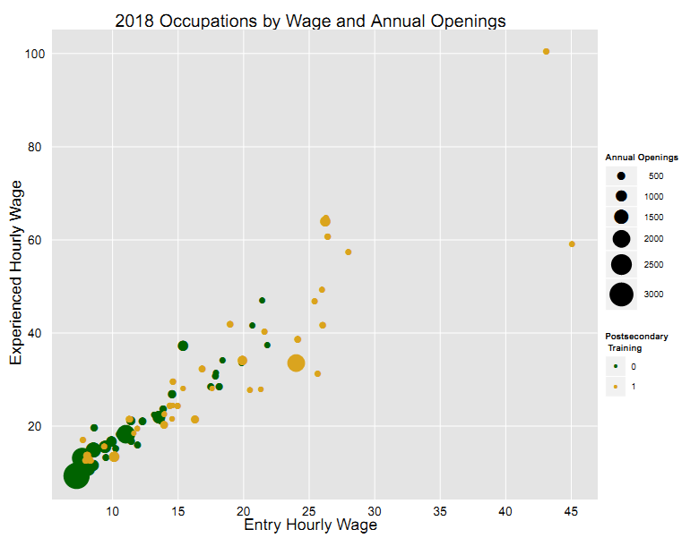
Chief Executive
High wage jobs require training after high school
Waitstaff, food service, etc.
Pharmacist
Customer service
Lawyers
Registered nurses

Slide 14
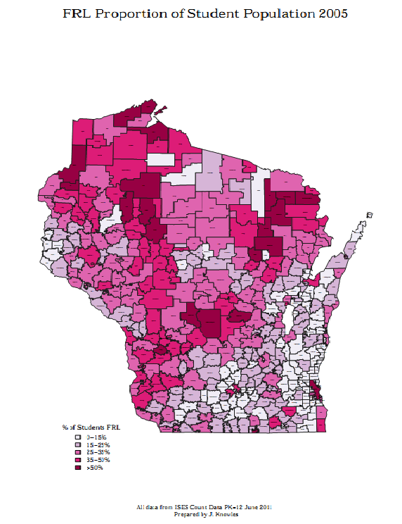
Growing Poverty
Proportion of students living in poverty in 2005
Notes:
This is how we were.

Slide 15
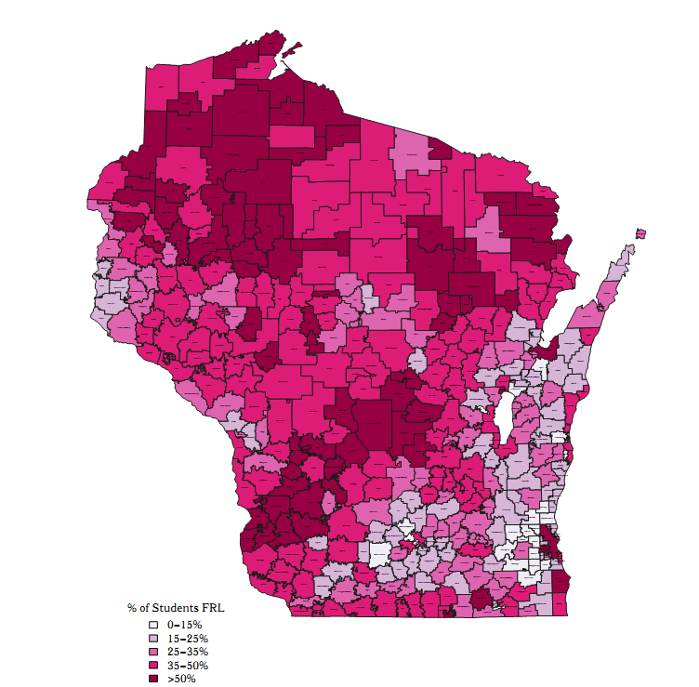
Poverty today
Notes:
Some of our districts go from 0 to 50% FRL in a single 6 year period. Almost all others exhibit a 10%+ increase in FRL students

Slide 16
The Future — Racial Change
Data calculated from NCES projections from 2009

Slide 17
Where do we struggle to educate children?
Achievement Gaps

Slide 18
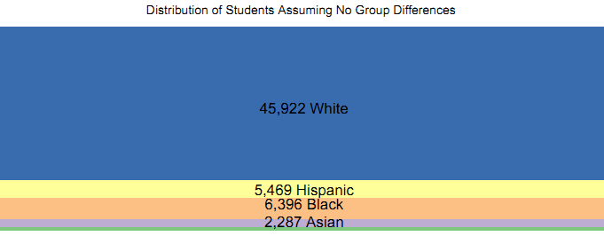
Racial Breakdown of Grade 4 in 2009-2010

Slide 19
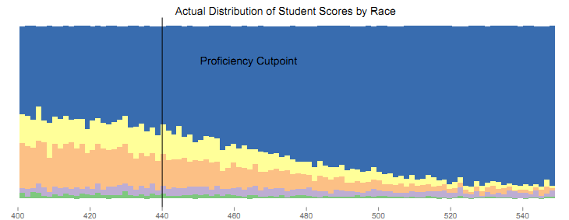
Conditional Density of G4 WKCE Reading
Students of color make up a much larger proportion of our low performing students
Notes:
The plot shows the proportion of students in each racial category for each scale score range on the WKCE. If there were no racial disparities the groups would be perfect rectangles like in the previous slide. As it is, the steeper the angle between the categories, the more significant the achievement gap.

Slide 20
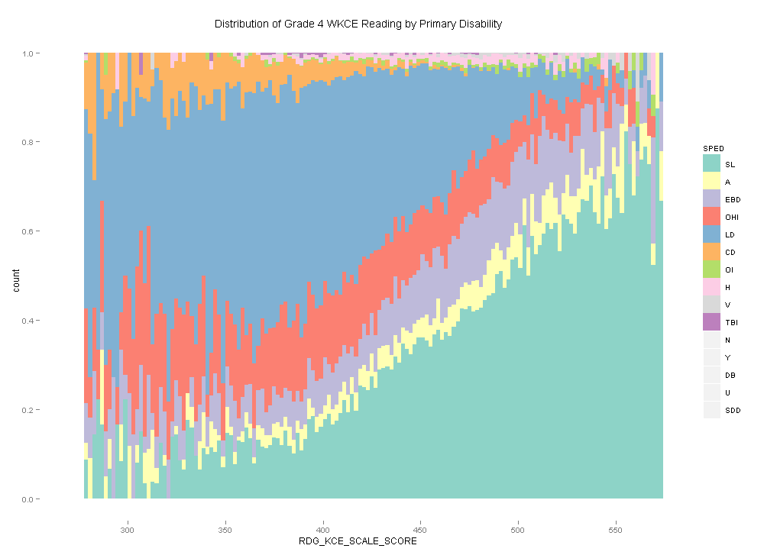
Specific LD– 15,613
There are large disparities among the disability classifications in performance
Speech and Language– 13,962

Slide 21
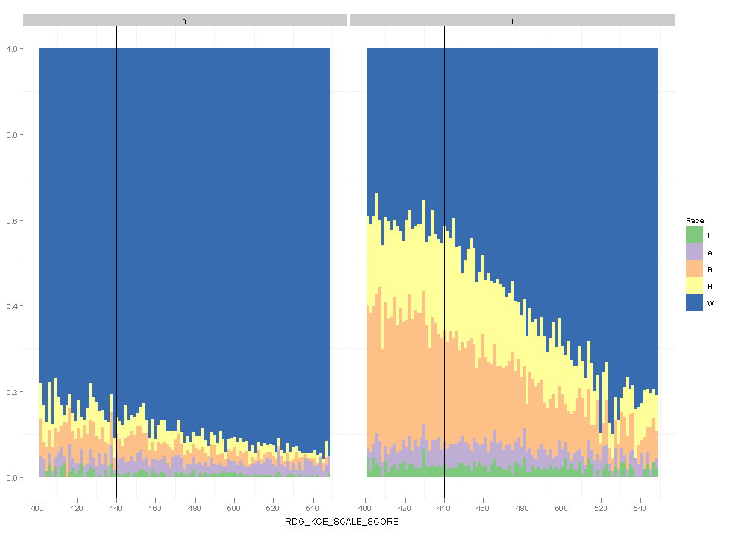
Split by Economic Disadvantage
Racial gaps exist across economic differences
Notes:
Same as the last plot, but divided by FRL status. Clearly the achievement gap is much worse for students in poverty.

Slide 22
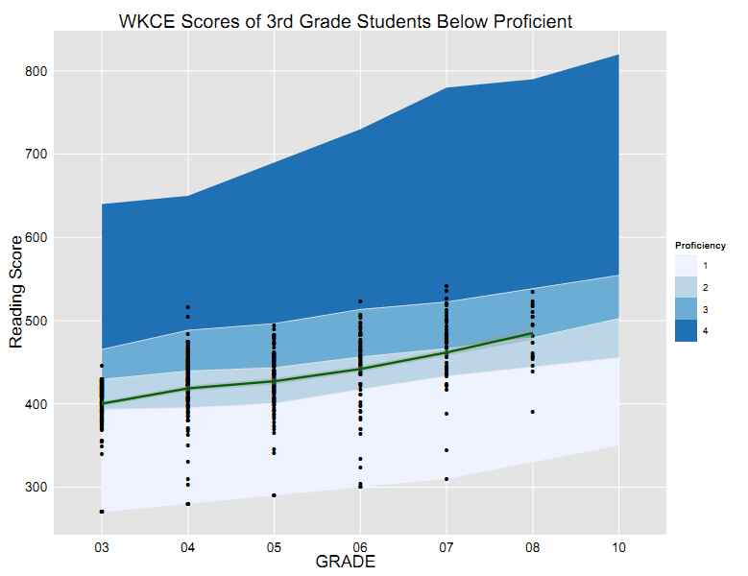
Students that start below proficient on average stay below proficient

Slide 23
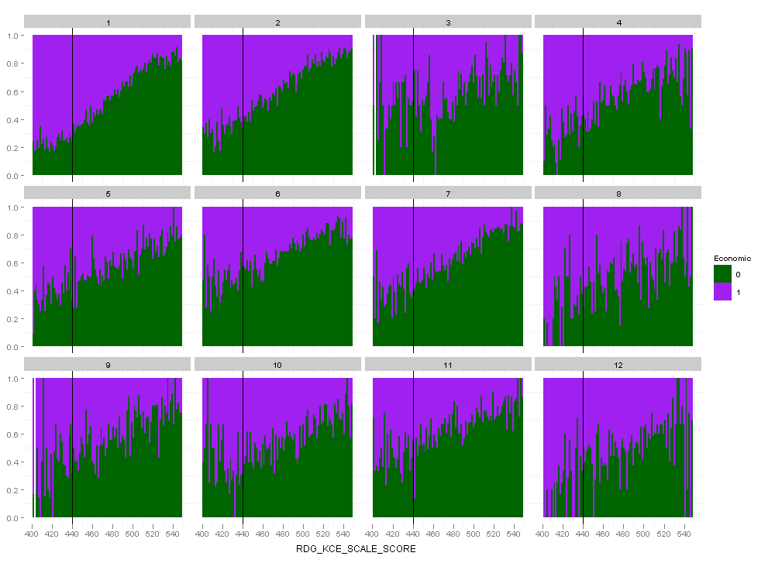
Econ Gap Split by CESA
Economic gaps exist across regions of the state
Notes:
Consistent across CESAs (despite noise from low student numbers).

Slide 24
When can we help kids most?
Transitions

Slide 25
Why transitions?
By focusing on predicting student outcomes we can intervene early and more effectively
Several indicators give a good idea of student achievement in the near and long-term that are available immediately
  Disciplinary events
  Attendance and engagement
  Prior test record
  Language acquisition
At different points in time there will be different indicators that matter more, but the key is focusing on what they say about the likely future

Slide 26
What kinds of indicators matter?
Research shows that a number of indicators can provide an ‘early warning’
  6th grade attendance
  Disciplinary events (suspensions, expulsions) early in a student’s career
  Course completion and instructional time in 9th grade
  Standardized test performance
  Failing courses in high school
  Direct measures of student engagement

Slide 27
Dropouts Matter

Slide 28
From Reaction to Prediction—An Example
WKCE + Behavior
WKCE / ACT
College / Career Outcomes
In early grades we predict later grade WKCE with behavior and test results
Using predictions about late WKCE link to ACT performance we calculate ACT performance
ACT provides a stable link to college performance

Slide 29
What does this mean?
So we can use this WKCE / ACT link to estimate what ‘track’ a student is on early in career
Interventions can be targeted, benchmarks set, and changes made to move student upward—starting backward from the premise of ACT scores
We can do some of this today to estimate how current graduates may perform

Slide 30
Some Estimates of College Success
2008-2011 ACT Takers
Breaking scores down into bands predictive of college success (<18, 19, 20-21, 22-26, 26+) and using historic rates of remedial coursework for those students from 2005-2007 ACT data, we can estimate that:
68,563 Wisconsin students (26% of ACT takers in this time) will need remedial coursework in mathematics
25,558 Wisconsin students (10%) will need remedial coursework in English
That is a full graduating cohort every four years requiring additional mathematics remedial work

Slide 31
English Remediation Projections 2008-2011 ACT
ACT English Score | Avg. Remediation Rate | Students | Average Rate of Completing Remediation in One Year | Students not on track in year 2 of college
<18 | 30% | 23,019 | 70% | 6,906
19 | 6% | 914 | 70% | 274
20-21 | 2.9% | 1,230 | 70% | 369
22-26 | 0.5% | 395 | 70% | 119
26+ | 0% | 0 | 70% | 0
TOTAL |  |  |  | 7,668

Slide 32
Math Remediation Projections 2008-2011 ACT
ACT Math Score | Avg. Remediation Rate | Students | Average Rate of Completing Remediation in One Year | Students not on track in year 2 of college
<18 | 67% | 51,736 | 60% | 20,694
19 | 37% | 5,564 | 60% | 2,226
20-21 | 20% | 1,230 | 60% | 492
22-26 | 6% | 5,423 | 60% | 2,169
26+ | 0.3% | 152 | 60% | 91
TOTAL |  |  |  | 25,672

Slide 33
Students that start below proficient on average stay below proficient

Slide 34
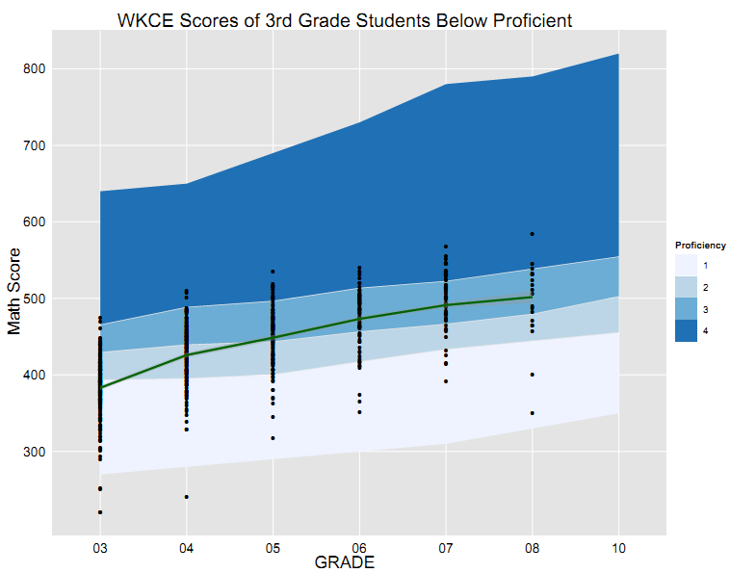
Students that start below proficient in reading can move into above proficient in math

Slide 35
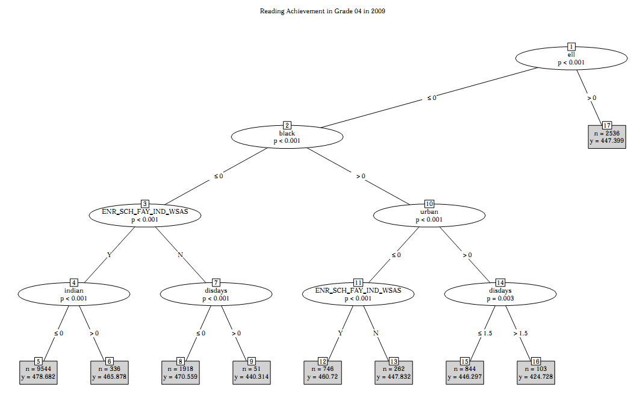
Grade 4 Reading Achievement 2009-10
FRL Students
Excluding MPS and SwD
ELL
ELL status, race, mobility, and disciplinary status sharply divide student achievement
black
FAY
urban
indian
discipline
FAY
discipline

Slide 36
Literacy is Foundational
Reading and beyond

Slide 37
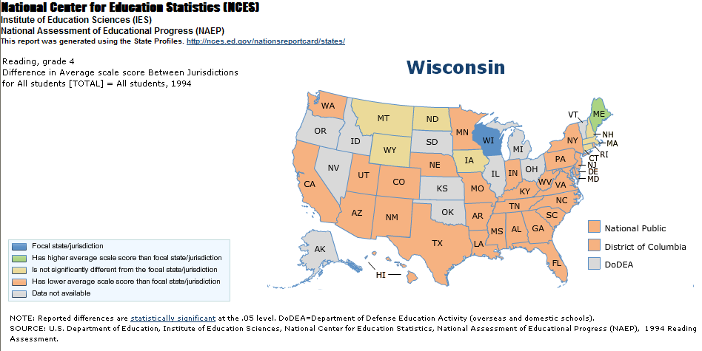
NAEP Performance in 1994
Few states rank above WI in 1994

Slide 38
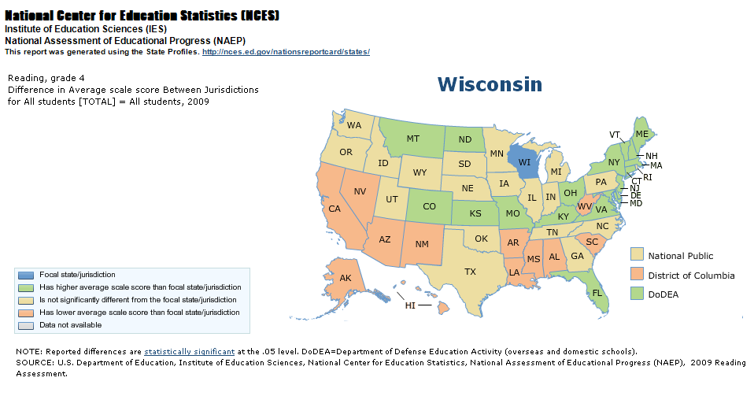
NAEP Performance in 2009
More states rank above WI in 2009

Slide 39
Correlation of WKCE Subjects in Grade 4
Reading correlates with other subjects more than math

Slide 40
Correlation of WKCE Subjects in Grade 8
Reading correlates with other subjects more than math

Slide 41
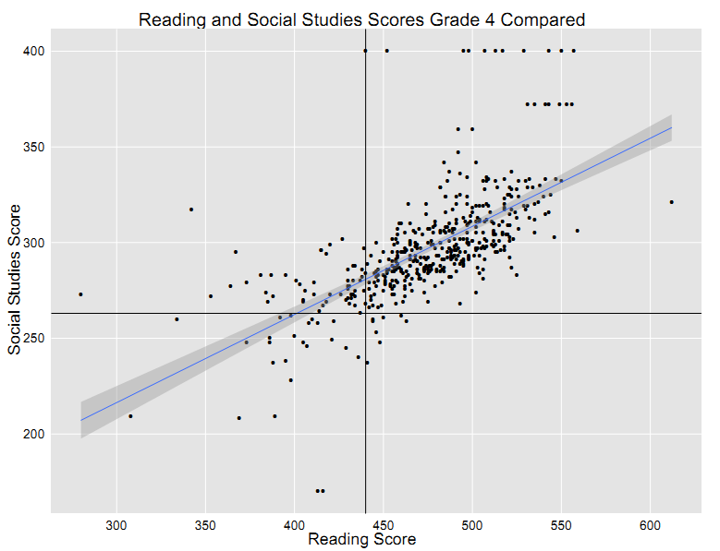

Slide 42
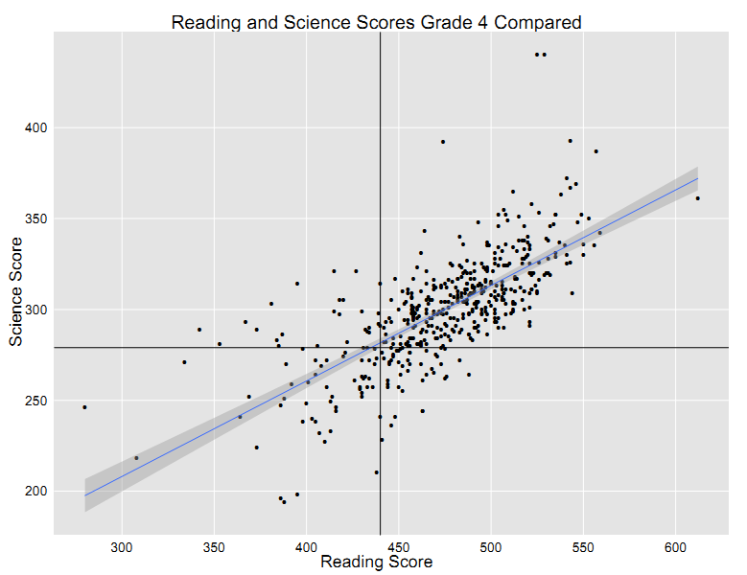

Slide 43
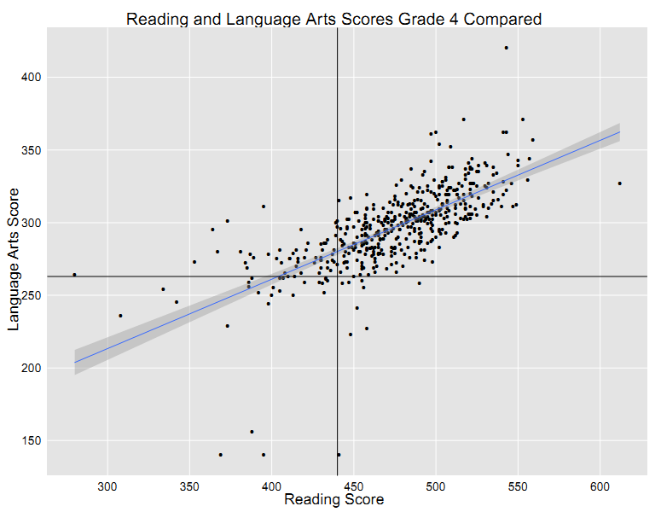

Slide 44
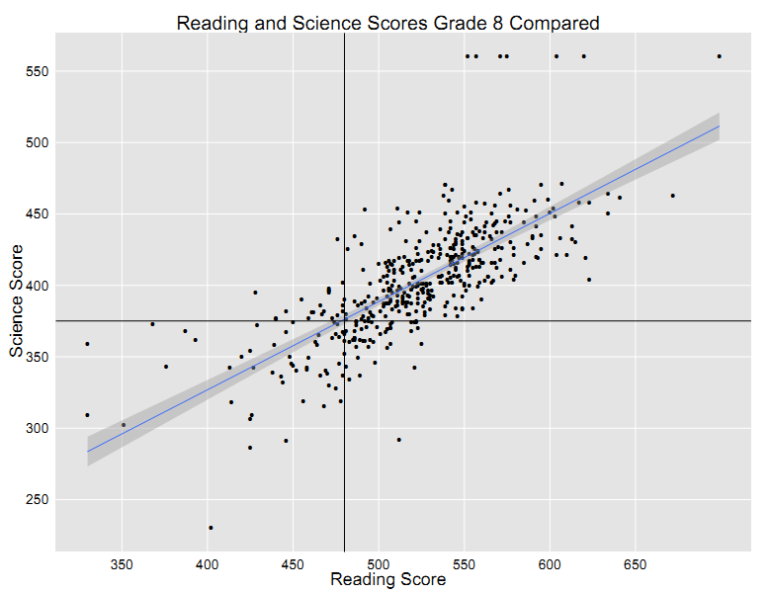

Slide 45
Questions?
Extra slides available

Slide 46
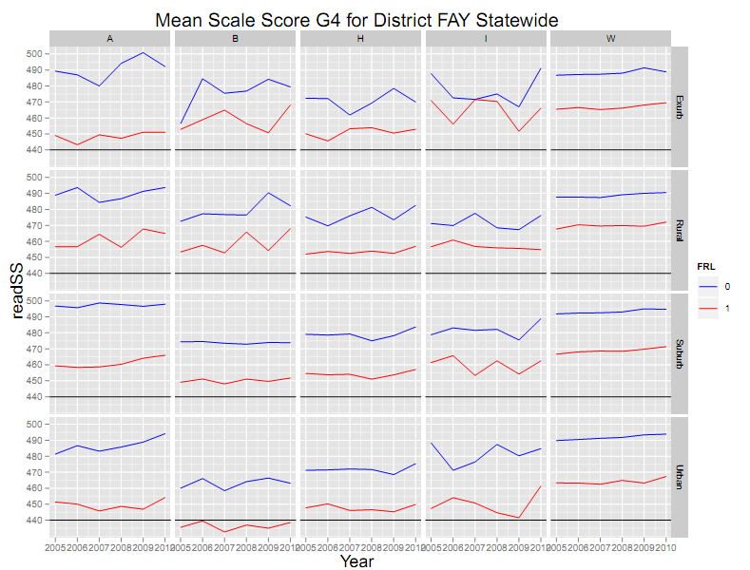
Economic Gap by Race and Locale
Notes:
Consistent across CESAs (despite noise from low student numbers).

Slide 47
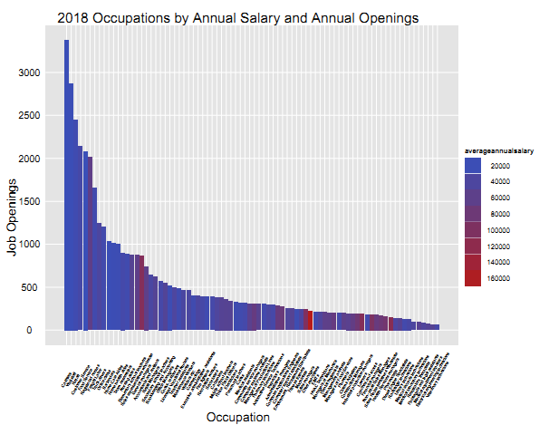

Slide 48
