Slide 1
Building and Deploying an Early Warning System: Lessons Learned from a Large Scale Pilot
Jared Knowles
Research Analyst
Wisconsin Department of Public Instruction
STATS-DC July 2013
Washington, D.C.

Slide 2
Agenda
Principles for a Dropout Early Warning System
Building a Statewide DEWS
Piloting a DEWS
Learning from the Pilot
Deploying Statewide?

Slide 3
Why DEWS?
Push early warning systems to be earlier
Focus on extracting information from data already reported by LEAs to the SEA
Statewide scale, leveraging multiple years of data in the LDS
Built on open-source software that can adapt to additional data and different contexts

Slide 4
Challenges with DEWS?
Resonance – school principals have to see this fitting in their work
Ease of Use – minimal barriers to opening up and using the system
Accuracy – cannot give bad information to LEAs
Coverage– as many students included as possible
Transparency – needs to be a system LEAs trust

Slide 5
DEWS Refresher
DEWS score calculated using a combination of demographic and student outcome measures to improve accuracy
  Attendance, disciplinary events, assessment scores, and student mobility
Student risk is calculated individually for each student
Students are classified as at risk if their score crosses a threshold set by DPI; districts can use this or ignore it

Slide 6
DEWS Refresher
DPI early warning system is called the Dropout Early Warning System, or DEWS
DEWS provides a score from 0-100 for current 6th, 7th, and 8th graders
The score represents the rate at which students similar to the current student in previous cohorts graduated
A score of 75 means that 75% of prior students with similar characteristics graduated on time

Slide 7
DPI’s System is in Development
More than 60% of students who eventually do not graduate after 4 years of high school can be identified with current data before the start of 7th grade
DPI is working to improve this through better techniques to allow students to be identified earlier and with more accuracy
The system will continually improve with better data, better mathematical models, and more real time results

Slide 8
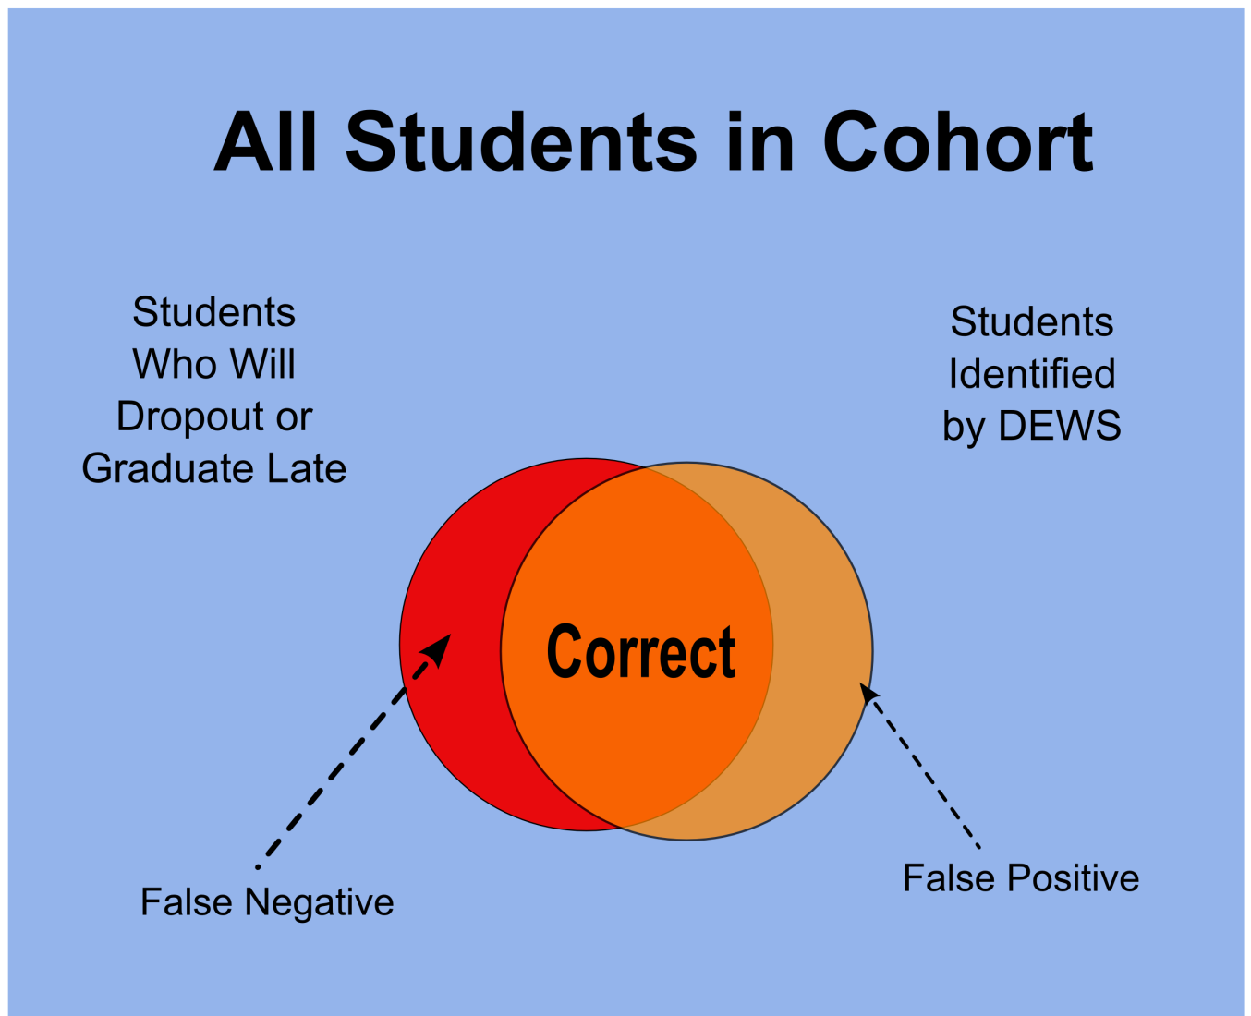
Classification

Slide 9
Project Plan
DEWS was developed during the 2012-13 school year
Pilot group of 34 schools identified in early 2013
Pilot materials delivered electronically in mid-April 2013; participation in follow-up survey too
  Interpretative guide
  Student reports for all current 7th graders
  School report
  School roster
Pilot materials mimic WISEdash, final scheduled for September 2013 rollout in WISEdash

Slide 10
Awareness and Communications
Title I Coordinators
Accountability Trainers
Statewide PBIS Network
CESA Support Network
SSEDAC
School Administrators Alliance
School Counselors Association
WERAC
National Forum on Education Statistics
REL Midwest
Partners at WCER
Department of Children and Families
Members of WISEexplore

Slide 11
DEWS Process
STATE DATA
LOCAL KNOWLEDGE
Assessments
Teacher / program context
Parent input
Special circumstances
CONTEXT
Demographics
Attendance
Intervention Strategies
Disciplinary Events
Mobility
Location
Student Risk Identification

Slide 12
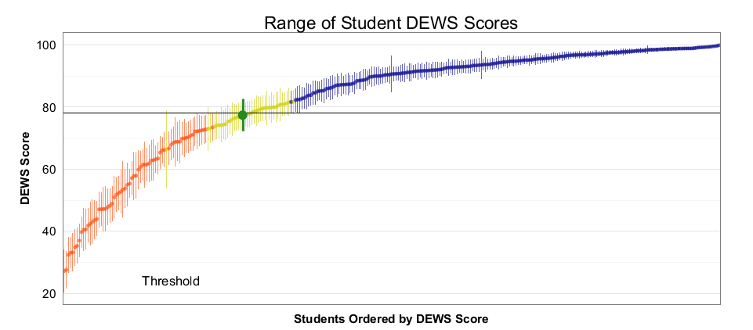
Pilot Reports

Slide 13
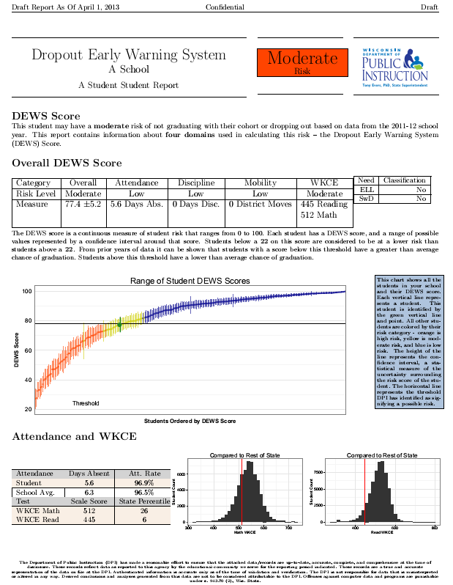
Pilot Reports - Student

Slide 14
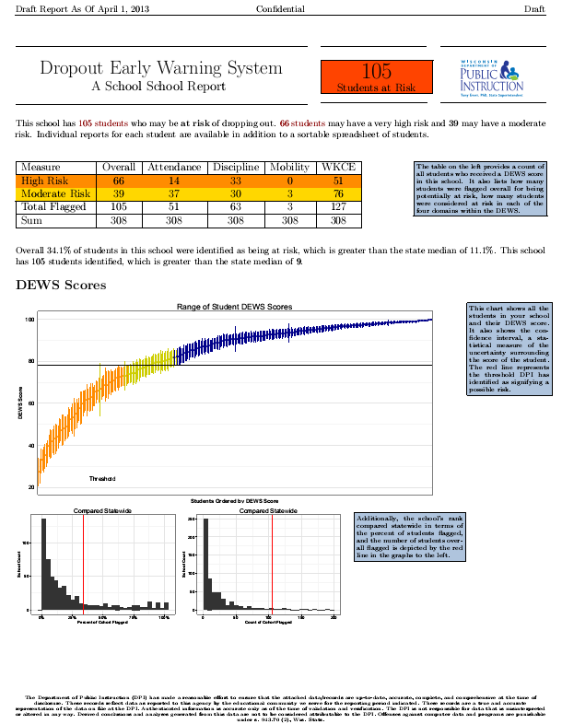
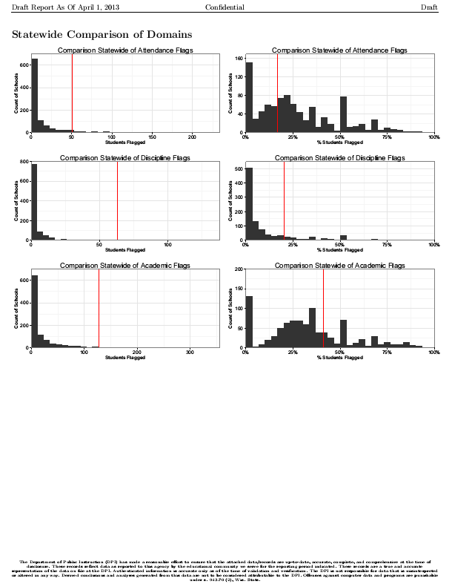
Pilot Reports - School

Slide 15
Survey Results
Survey sought to identify the utility of the DEWS reports in relation to existing Early Warning System / identification measures
Asked about:
usefulness of DEWS report
usefulness of interpretation guides
desire to have DEWS available
WISEdash usage
Likelihood to use WISEdash if DEWS included

Slide 16
Survey Summary
18 of the 34 participating pilot schools have responded to the survey so far (52.9%)
15 of the respondents indicated they “fully reviewed” the results
6 schools have been interviewed
5 schools said staff reviewed the reports individually, 11 said staff reviewed them in a group working together

Slide 17
DEWS Overall Valuable!

Slide 18
DEWS Identifies Students Missed

Slide 19
DEWS Does Not Miss Many Students

Slide 20
Student reports are most positive element

Slide 21
The Student Roster is Valuable

Slide 22
School reports are well liked

Slide 23
Most respondents expect DEWS to be used at least annually

Slide 24
Annual Delivery Before School Year is Strongly Preferred

Slide 25
DEWS can drive WISEdash usage

Slide 26
Principals and Student Services Staff Must Have WISEdash access

Slide 27
DEWS Beyond Fall 2013
DEWS as it exists is just a start. Several extensions for DEWS may be desired:
Deeper WISEdash integration?
Communication and professional development to raise awareness and use for informing interventions?
Extend coverage to earlier and later grades
Increase accuracy?
Add college-enrollment as a secondary warning?

Slide 28
Interview Quotes
“Great to have a system that doesn’t require additional reporting or information from us!”
“This would be a fantastic resource to be able to share with parents in fall teacher conferences.”
“Inclusion of mobility in the system covers a big blind spot for us as an LEA.”
“Thank you for getting feedback early in the process from us!”
“Want to use this list as a starting point for our intervention planning teams.”
“Having an 8th grade score for incoming 9th graders will be crucial to planning!”

Slide 29
Interview Quotes
“This information is easy to understand and quick to be processed so we can hit the ground running with ours staff.”
“Summarizing all this data in one place for us saves us time so we can get to identifying additional data needed to identify interventions.”

Slide 30
Questions?
Contact Me
E-mail: jared.knowles@dpi.wi.gov
GitHub: www.github.com/jknowles
Twitter: @jknowles
Google + : profiles.google.com/jknowles
Web: www.jaredknowles.com

