Slide 1
Perspectives on Working in Government
Jared Knowles, Research Analyst at the Wisconsin Department of Public Instruction

Slide 2
Working in Government

Slide 3

There is some of this…

Slide 4

And this….

Slide 5

And days like this….

Slide 6
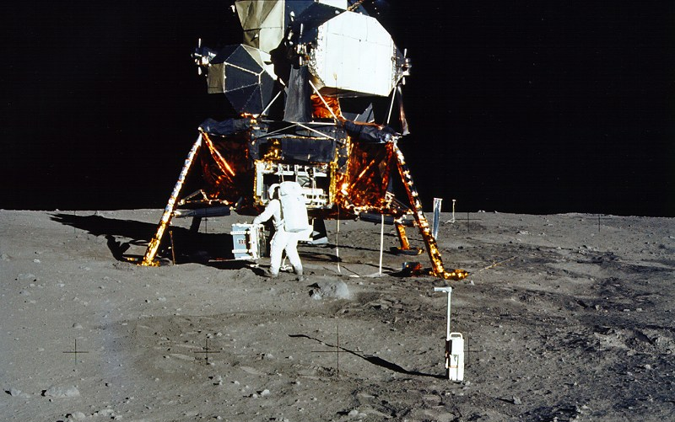
But, government did this…
ALLEGEDLY ☺

Slide 7
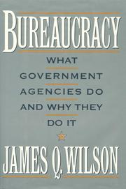
Read This Book
Why government is different than the private sector, and why that explains everything
Explains difficulties, challenges, and the benefits of the bureaucracy

Slide 8
Working In A Bureaucracy
“Many, if not most, of the difficulties we experience in dealing with government agencies arise from the agencies being part of a fragmented and open political system…The central feature of the American constitutional system—the separation of powers—exacerbates many of these problems. The governments of the US were not designed to be efficient or powerful, but to be tolerable and malleable. Those who designed these arrangements always assumed that the federal government would exercise few and limited powers.”

Slide 9
Efficiency
“The problem with government is that government can’t say, ‘yes’ … there is nobody in government that can do that. There are fifteen or twenty people who have to agree. Government has to be slower. It has to safeguard the process. “ p. 317
“The economic definition of efficiency assumes there is only one valued output… But government has many valued outputs, including a reputation for integrity, the confidence of the people, and the support of important interest groups.” p. 317

Slide 10
Challenges
Retention: staff turnover threatens policy/program continuity constantly
Careerism: institutional advancement is preferred over other goals
Inertia: things aren’t made to move quickly, many programs already in place
Red tape: multiple layers of approval are required for many actions
Bandwidth: too many parallel tasks, not enough time to process
Multiple Masters: serve the will of the public, legislature, and interest groups simultaneously

Slide 11
Tools to Meet Them
Relationships: building coalitions, working across the agency or across government, networks of resources outside
Relationships: intentionally repeated, can’t be repeated enough
Reputation: work hard to build a reputation for fairness, accuracy, and timeliness
Data: government is awash with data, use it to make your case—find it, assemble it, repeat it
Marketing: explaining your ideas and your results so that others advance them

Slide 12

Retention

Slide 13
Retention
Retention
Coalitions need to be flexible because good people will leave
Retirements and turnover create openings for new ideas and rethinking the way things are done
Keep an open mind!

Slide 14

Careerism

Slide 15
Careerism
Careerism
Learn about and master institutional incentives
In a multiple incentive environment, you can build coalitions around alternate goals
Find more allies

Slide 16

Inertia

Slide 17
Inertia
Inertia
Be prepared to make the case for change many times, many ways
Build a coalition of like-minded folks with the same goal
Attach efforts to other programs with momentum

Slide 18

Red Tape

Slide 19
Red Tape
Red Tape
Find strategic partners for initiatives—management, experts, outside groups with funding
Don’t take it personally
Recognize and validate the need for red tape to protect taxpayers

Slide 20
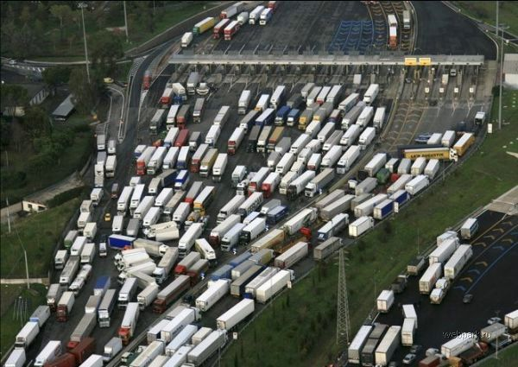
Bandwidth

Slide 21
Bandwidth
Bandwidth
Need broad coalitions of busy folks to move things forward
Need to improve efficiency in other areas to free up time for innovative projects
Frank discussions with management
PARALLELISM

Slide 22
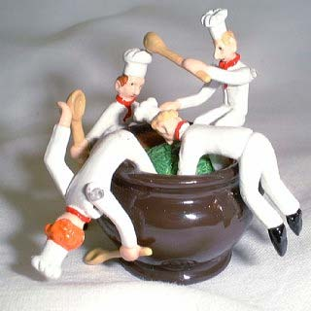
Multiple Masters

Slide 23
Multiple Masters
Multiple Masters
Turn from a virtue to a vice when you can—multiple places to promote a project
Be cautious about expending resources for a given program
Get clear direction and a promise to support a project from management

Slide 24
Why should you do it?
All big organizations face these challenges
Government work matters—despite rumors of its lack of utility
Service—government needs talented folks to be better, you could be part of the change
Perspective—serving multiple masters, working on keeping things running, and understanding how government operations get carried out is humbling!
Constraint is a challenge of its own—good experience at building coalitions to get things done

Slide 25
Government in the Digital Age
Open source tools—use them
If you build on quality open-source tools you can share with more organizations, build coalitions across agencies, and draw on the wisdom of the crowd, even when that crowd might not be interested in your policy area!
Share digitally and take information to where your people are
Service > compliance – government is competing for brand recognition

Slide 26

Questions?

Slide 27
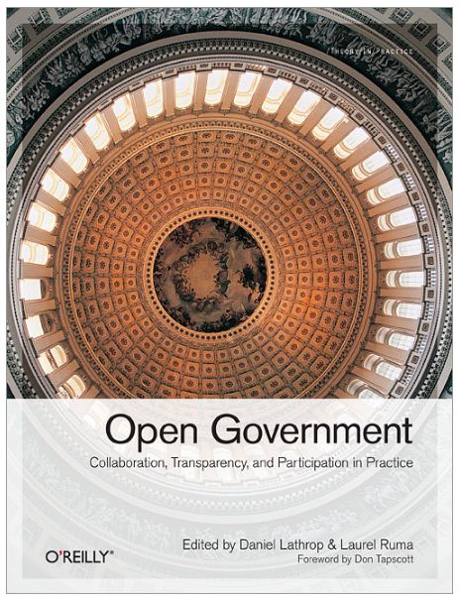
Resources
James Wilson. Bureaucracy
Open Government: Collaboration, Transparency, and Participation in Practice. O’Reilly Media (FREE: https://github.com/oreillymedia/open_government)
Learn more: www.jaredknowles.com
@jknowles

Slide 28
Why it matters?
Working with others is key to success in government—proprietary tools limit your options
  Though, standard tools are perfectly OK!
Being able to share things on the Web is a pervasive concern of all organizations, web tools work well with open-source tools
Many tasks require immense flexibility—something open source tools give you
Responsiveness, openness, and flexibility

